Slide 1
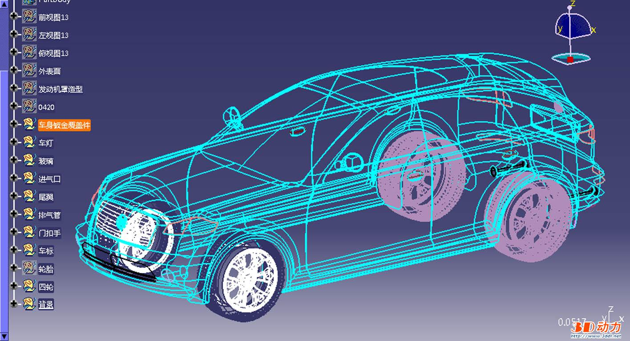
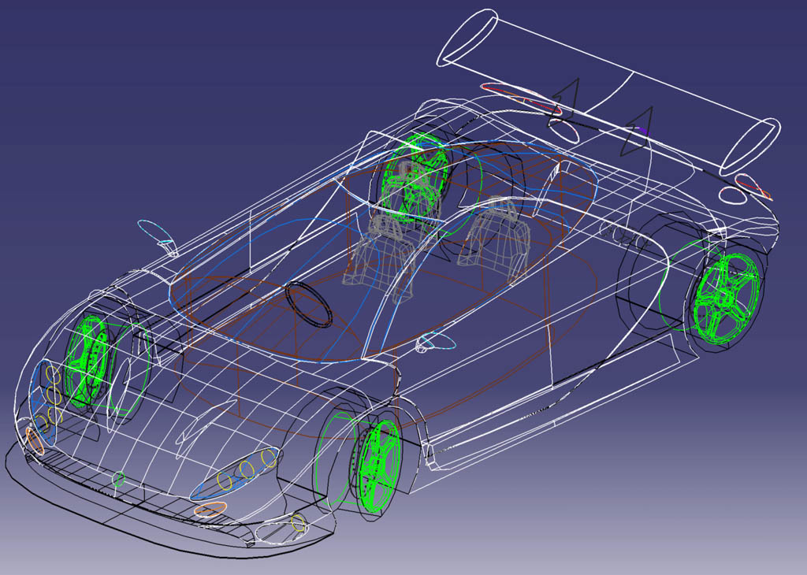
计算机高级图形学
Chapter 8 Hidden Surface Removal

Slide 2
3D Rendering Pipeline
3D Primitives
3D Modeling Coordinates
Model Transformation
3D World Coordinates
Lighting
3D World Coordinates
Viewing Transformation
3D Viewing Coordinates
Projection Transformation
2D Projection Coordinates
Clipping
Hidden
Surface
Removal
2D Projection Coordinates
Viewport Transformation
2D Device Coordinates
Scan Conversion
2D Device Coordinates
Image

Slide 3


Hidden Surface Removal
Motivation
Algorithms for HSR
  Back-face detection
  Painter’s algorithm
  Ray casting
  Scan-line
  Z-buffer
  Area subdivision

Slide 4
Motivation
Surfaces may be Back-Facing:
Back-Facing
Polygon
Viewer
Surfaces may be Occluding:
Viewer
Occluding
Polygon
Occluded
Polygon

Slide 5
Motivation
Surfaces may be Overlapping:
Viewer
Surfaces may be Intersecting:
Viewer

Slide 6
Algorithms
Back-Face Detection
Painter’s Algorithm
Ray Casting
Scan-Line
Z-Buffer
Area Subdivision

Slide 7
Back-Face Detection
Do not Render any Surface Oriented Away from Viewer
Back-Facing
Polygon
V
N
3D Primitives
Model Transformation
Viewer
Lighting
Polygon is back-facing to the viewer if V•N < 0
Viewing Transformation

Slide 8
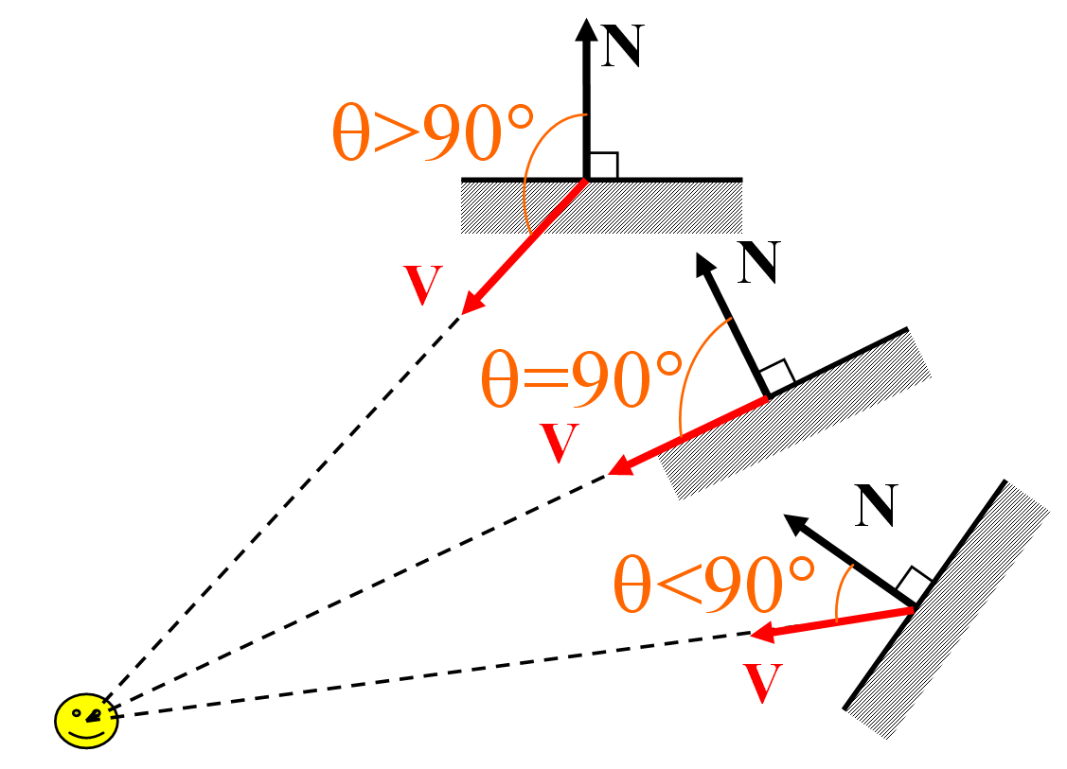
Back-Face Detection
  N⋅V<0：invisible
  N⋅V≥0：visible
V·N=|V||N|cosθ

Slide 9
Depth Sort
Painter’s Algorithm:
  Sort surfaces in order of decreasing maximum depth
  Scan convert surfaces in order starting with ones of greatest depth, reordering as necessary based on overlaps
A
D
E
Viewer
C
Viewport Transformation
View
Plane
B
Scan Conversion
Depth Sort
Image

Slide 10
Depth Sort
Comments
  O(nlogn)
  Intersecting polygons must be subdivided
  Sort order has lots of frame-to-frame coherence during walkthroughs
  Must fully compute every pixel for every polygon
  Used most often with BSP or static list-ordering

Slide 11
Ray Casting
Algorithm:
  Cast ray from viewpoint through each pixel to find front-most surface
A
D
E
3D Primitives
Model Transformation
Viewer
C
Lighting
View
Plane
B
Viewing Transformation

Slide 12
Ray Casting
Comments
  O(plogn) for p pixels
  May (or may not) utilize pixel-to-pixel coherence
  Conceptually simple, but not generally used

Slide 13
Z-Buffer
Algorithm:
  Store color and depth of closest surface for each pixel in frame buffer
  As scan convert, update only pixels whose (interpolated) depth is closer than the depth stored in the frame buffer
z=3
z=1
z=5
Viewport Transformation
z=4
z=2
Scan Conversion
z=5
z=5
Image

Slide 14
Z-Buffer
Comments
  Polygons can be rasterized in any order
  Requires lots of memory
  Requires per pixel processing, subject to aliasing (A-buffer)
  Commonly implemented in hardware
Notes:
Aliasing:混淆或重叠

Slide 15
Scan-Line
Algorithm:
  For each scan line, construct spans and sort by depth
z=3
z=1
z=5
Scan
Line
z=4
z=2
Viewport Transformation
z=5
z=5
z=1.8
z=3.8
Scan Conversion
Example:
Spans
Image
z=5
z=5

Slide 16
Scan-Line
Comments
  Fully compute only front-most pixels
  Coherence along scan lines
  Commonly implemented in software

Slide 17

Area Subdivision
Algorithm:
  Fill area if:
    All surfaces are outside
    Only one surface intersects
    One surface occludes other surfaces within area
  Otherwise, subdivide

Slide 18
Conclusion
Hidden surface algorithms
  Back-face detection
  Depth sort
  Ray casting
  Z-buffer
  Scan-line
  Area subdivision
Hardware
  Z-buffer
Software
  Depth sort
  Scan-line

